Slide 1
CHAPTER-10
Error Detection and Correction

Slide 2
Basic concepts
Networks must be able to transfer data from one device to another with complete accuracy.
Data can be corrupted during transmission (three impairments: attenuation, distortion, noise).
For reliable communication, errors must be detected and corrected.
Error detection and correction are implemented either at the data link layer or the transport layer of the OSI model.

Slide 3


Errors
Whenever bits flow from one point to another, they are subject to unpredictable changes because of interference. This interference can change the shape of the signal.

Slide 4
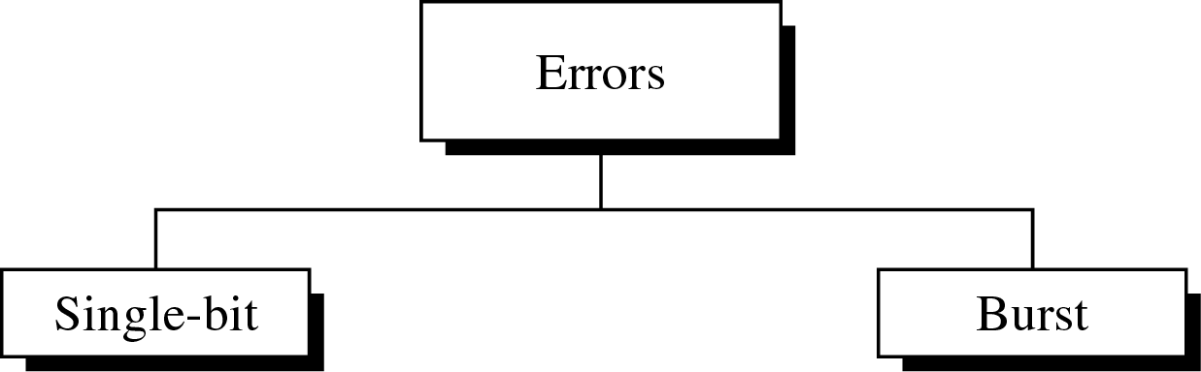
Types of Errors

Slide 5

Single-Bit Error
The term single-bit error means that only 1 bit of a given data unit (such as a byte, character, or packet) is changed from 1 to 0 or from 0 to 1.

Slide 6

Burst Error
The term burst error means that 2 or more bits in the data unit have changed from 1 to 0 or from 0 to 1.

Slide 7
10.1.2 Redundancy
The central concept in detecting or correcting errors is redundancy.
To be able to detect or correct errors, we need to send some extra bits with our data.
These redundant bits are added by the sender and removed by the receiver.
Their presence allows the receiver to detect or correct corrupted bits.

Slide 8
Detection Versus Correction
The correction of errors is more difficult than the detection.
In error detection, we are looking only to see if any error has occurred. The answer is a simple yes or no. We are not even interested in the number of errors. A single-bit error is the same for us as a burst error.

Slide 9
Cont.
In error correction, we need to know the exact number of bits that are corrupted and more importantly, their location in the message.
The number of the errors and the size of the message are important factors.
  If we need to correct one single error in an 8-bit data unit, we need to consider 08 possible error locations; if we need to correct two errors in a data unit of the same size, we need to consider 28 possibilities (permutation of 8 by 2). You can imagine the receiver's difficulty in finding 10 errors in a data unit of 1000 bits.
Combination hobe maybe

Slide 10
10.2 Block coding
In block coding, we divide our message into blocks, each of k bits, called datawords.
We add r redundant bits to each block to make the length n = k + r. The resulting n-bit blocks are called codewords.
For the moment, it is important to know that we have a set of datawords, each of size k, and a set of codewords, each of size of n.

Slide 11

Error Detection
How can errors be detected by using block coding? If the following two conditions are met, the receiver can detect a change in the original codeword.
  1. The receiver has (or can find) a list of valid codewords.
  2. The original codeword has changed to an invalid one.

Slide 12
Cont.
The sender creates codewords out of datawords by using a generator that applies the rules and procedures of encoding.
Each codeword sent to the receiver may change during transmission. If the received codeword is the same as one of the valid codewords, the word is accepted; the corresponding dataword is extracted for use. If the received codeword is not valid, it is discarded.
However, if the codeword is corrupted during transmission but the received word still matches a valid codeword, the error remains undetected.
This type of coding can detect only single errors. Two or more errors may remain undetected.

Slide 13
Cont.
Example 10.2
Let us assume that k =2 and n=3. Table 10.1 shows the list of datawords and codewords. Later, we will see how to derive a codeword from a dataword.
Table 10.1 A code for error detection (Example 10.2)
Datawords | Codewords
00 | 000
01 | 011
10 | 101
11 | 110

Slide 14
Cont.
Assume the sender encodes the dataword 01 as 011 and sends it to the receiver. Consider the following cases:
  1. The receiver receives 011. It is a valid codeword. The receiver extracts the dataword 01 from it.
  2. The codeword is corrupted during transmission, and 111 is received (the leftmost bit is corrupted).
  This is not a valid codeword and is discarded.
  3. The codeword is corrupted during transmission, and 000 is received (the right two bits are corrupted). This is a valid codeword. The receiver incorrectly extracts the dataword 00. Two corrupted bits have made the error undetectable.
An error-detecting code can detect only the types of errors for which it is designed;
other types of errors may remain undetected.

Slide 15
Hamming Distance
The Hamming distance between two words (of the same size) is the number of differences between the corresponding bits.
We show the Hamming distance between two words x and y as d(x, y).
The Hamming distance can easily be found if we apply the XOR operation (⊕) on the two words and count the number of 1s in the result.
    N.B: the result of XOR operation is 0 if two bits are the same; the result is 1 if the two bits are different.

Slide 16
Cont.
Note that the Hamming distance is a value greater than zero.
It is used for error detection or error correction when data is transmitted over computer networks.
Example 10.4
  Let us find the Hamming distance between two pairs of words.
  (1). The Hamming distance d(000, 011) is 2
  because 000 ⊕ 011 is 011 (two 1s).
  (2). The Hamming distance d(10101, 11110) is 3
  because 10101 ⊕ 11110 is 01011 (three 1s).

Slide 17
Minimum Hamming Distance
The minimum Hamming distance is the smallest Hamming distance between all possible pairs.
We use d_{min} to define the minimum Hamming distance in a coding scheme.
To find this value, we find the Hamming distances between all words and select the smallest one.

Slide 18
Cont.
Example 10.6
Find the minimum Hamming distance of the coding scheme in Table.
Table 10.1 A code for error detection (Example 10.2)
Datawords | Codewords
00 | 00000
01 | 01011
10 | 10101
11 | 11110

Slide 19
Cont.
Solution
We first find all Hamming distances.
d(00000, 01011) =3 d(00000, 10101) =3 d(00000, 11110)=4 d(01011, 10101) =4 d(01011, 11110) =3 d(10101, 11110) =3
The d_{min} in this case is 3.
4C2=6 combination..
Tai 6 ta possible pairs

Slide 20

10.4 Cyclic Redundancy Check
Figure 10.14 CRC encoder and decoder

Slide 21
Cont.
In the encoder, the dataword has k bits (4 here); the codeword has n bits (7 here).
The size of the dataword is augmented by adding
n - k (7-4 =3 here) 0s to the right-hand side of the word.
The n-bit result is fed into the generator. The generator uses a divisor of size n - k + 1 (7-4 +1 = 4 here), predefined and agreed upon.
The generator divides the augmented dataword by the divisor (modulo-2 division).
The quotient of the division is discarded; the remainder (r₂r₁r₀) is appended to the dataword to create the codeword.

Slide 22
Cont.
The decoder receives the possibly corrupted codeword. A copy of all n bits is fed to the checker which is a replica of the generator.
The remainder produced by the checker is a syndrome of n - k (7-4 =3 here) bits, which is fed to the decision logic analyzer.
The analyzer has a simple function. If the syndrome bits are all 0s, the 4 leftmost bits of the codeword are accepted as the dataword (interpreted as no error); otherwise, the 4 bits are discarded (error).

Slide 23

Example
Figure 10.15 Division in CRC encoder

Slide 24

Cont.
Figure 10.16 Division in the CRC decoder for two cases

